Slide 1


The Origins of Supermassive Black Holes
Cole Roberson
In collaboration with: Dr. R. Scott Barrows (University of Colorado, Boulder)
Sponsored By the Northern Arizona University NASA Space Grant Consortium

Slide 2

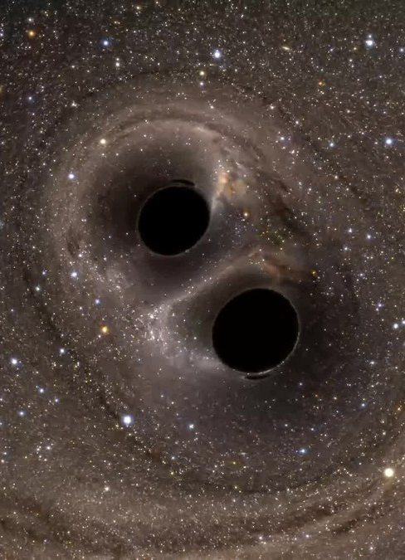

Background
Supermassive black holes grow as a result of different phenomena and are observed in the cores of galaxies
  Black Holes grow commonly from accretion of interstellar gas and dust
  Also can grow from mergers with other black holes
We attempt to address how these black holes grew to supermassive sizes ( > ${10}^{6}$ Solar Masses)

Slide 3

Background
To understand how supermassive black holes form we need to observe intermediate-mass black holes growing (${10}^{2}−{10}^{6}$ Solar Masses)
  One method is analyzing Hyper-luminous X-Ray Sources (HLXs)
    HLXs are off-nuclear x-ray sources found in the outer parts of galaxies that are extraordinarily bright
  Dim in visible but bright in X-Ray continuum
    Unlikely to be supermassive, likely intermediate

Slide 4
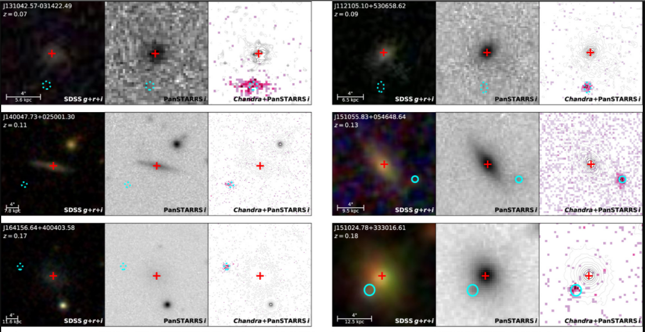
What we look for:
Xray sources could be in background
Step 1 is confirming the source has the same redshift as the galaxy – primary purpose of the observation, analysis of redshift
  We collected spectra of the subset of HLXs to compare the redshift
Color Composite
R - band
X-Ray
  Red Cross is host galaxy core
  Cyan is HLX candidate position
  Pink indicates X-Rays
R. Scott Barrows et al 2019 ApJ 882 181

Slide 5
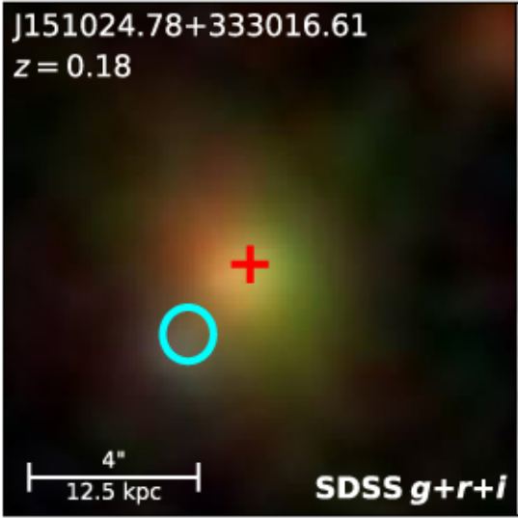
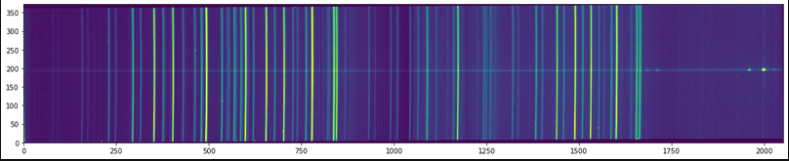
Long-Slit Spectroscopy of HLXs
Spectral Axis
Spatial Axis
Host Galaxy
Spatial Axis
HLX Candidate
Spectral Axis
This object is not the galaxy we studied, but I used this image to illustrate our analysis of the spectrum

Slide 6
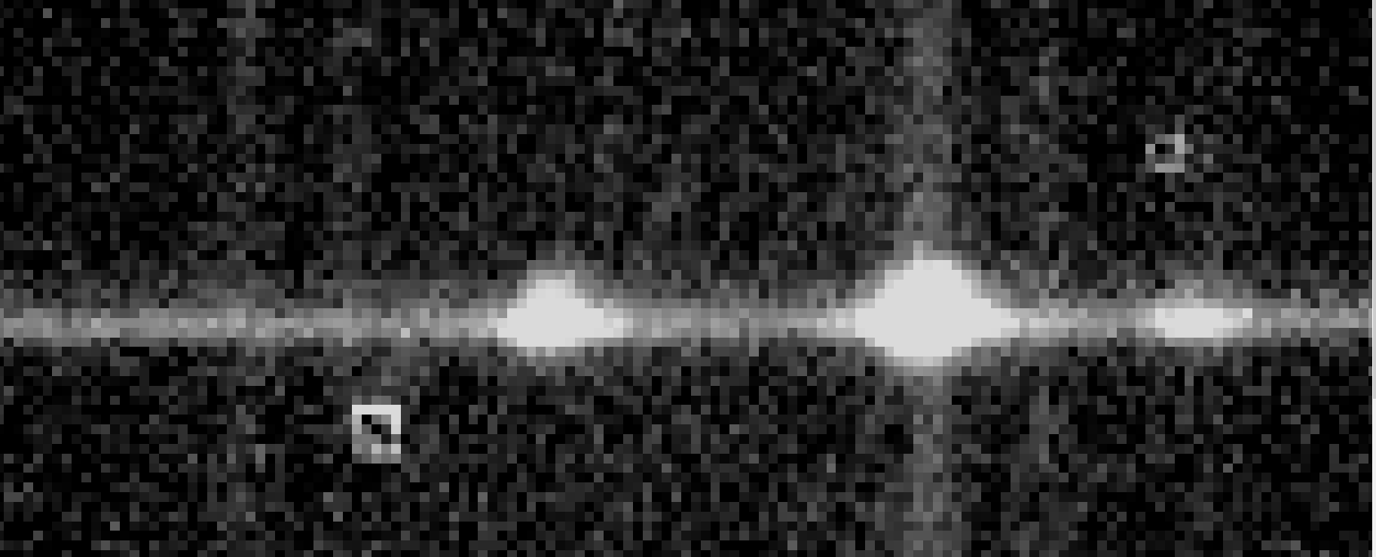
The extremely sharp peak is the Hydrogen – Alpha emission line
Our spectrum is taken from the SLOAN Digital Sky Survey and the object is J011258.35+153159.1
We expect the HLX to be about 3.81 pixels above the spectrum.
Spectral Axis
Host Galaxy
Spatial Axis
Spatial Axis
HLX Candidate
Spectral Axis

Slide 7
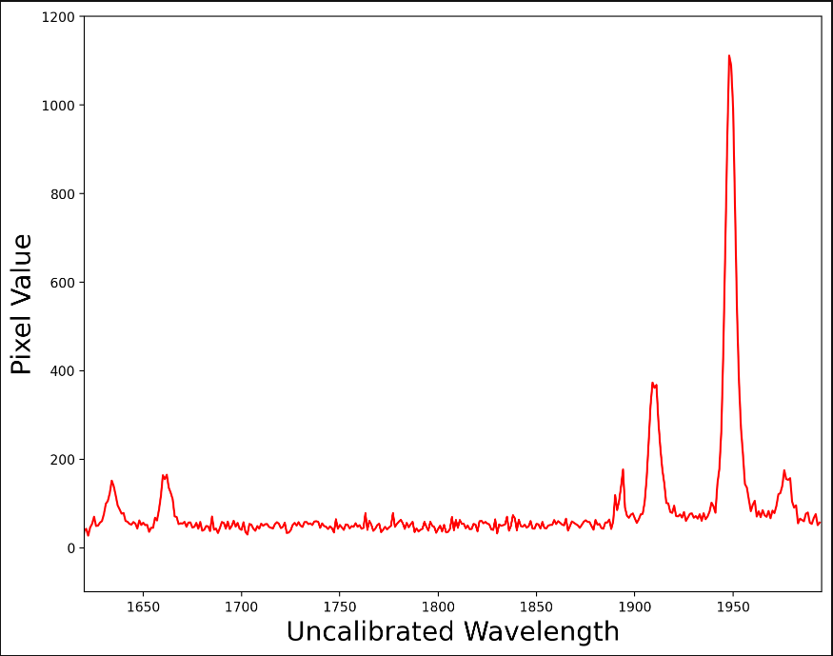
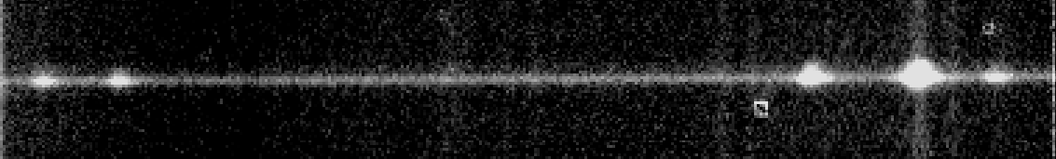
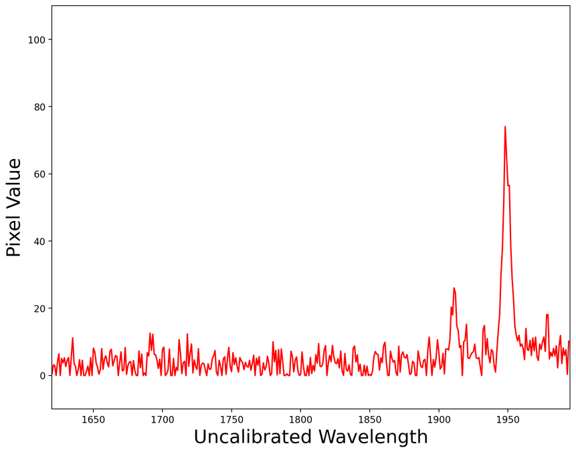
Is there an HLX?
H-α emission line →
Yellow wide aperture
[N II]
[O I]
[N II]
Spatial width = 5 pixels | range: y = (200, 205)
Green narrow aperture

Slide 8
Conclusions
We detected emission lines associated with the HLX candidate
The emission lines are at the same observed wavelength as those of the Host Galaxy
  Because of this, it is a true HLX and is interacting with the host galaxy
The HLX represents an actively accreting black hole 3.4 kpc from the center of the galaxy
  This black hole was likely at the center of a smaller galaxy that the observed galaxy consumed/merged
This merger likely triggered active accretion onto the black hole and produced strong detectable optical emissions and X-Rays
The mass of the black hole is unknown, but due to no detectable stellar components near it, it is likely an intermediate-mass black hole (IMBH)
Finally, this source represents an IMBH accreting matter and this process can lead to the growth of a SMBH

